Slide 1
IST 722
Merger of Fudgemart & Fudgeflix
Team 4
Aditya Kini
Akshay Sigar
Nikita Dongare
Nisha Rangnani
Rahul Wable
Siddhant Bandiwadekar

Slide 2
Project Overview
Fudge Corporation Ltd.
Fudgemart - An online store similar to amazon and walmart
FudgeFlix – A movie rental service similar to netflix
The need to merge for better processes
Goal- To ensure maximum profit and to satisfy customers needs.

Slide 3
Project Business Case
Analyze the needs of data warehouse
Improve business processes
Streamline the workflow
Scalability

Slide 4
Business Process
Order Fulfillment
Customer Satisfaction (ff_accounts, ff_account_titles, ff_titles,ff_title_genres,ff_genres,ff_directors,ff_zipcodes,ff_people)(fm_customers, fm_customer_product_reviews,fm_products, fm_department_lookup , fm_vendor )
Payroll Management
Sales Analysis
Title Rentals

Slide 5
Tools used
Main ETL tool used – Microsoft SSIS
Processes used - extract, transform and load
Microsoft Power BI tool
Create visualizations
Dashboards for executive decisions

Slide 6
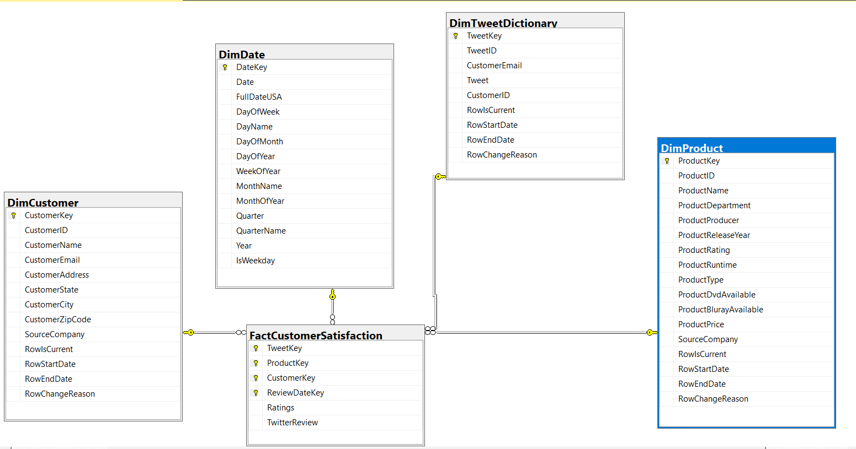
Star Schema

Slide 7
ETL Process Flow

Slide 8
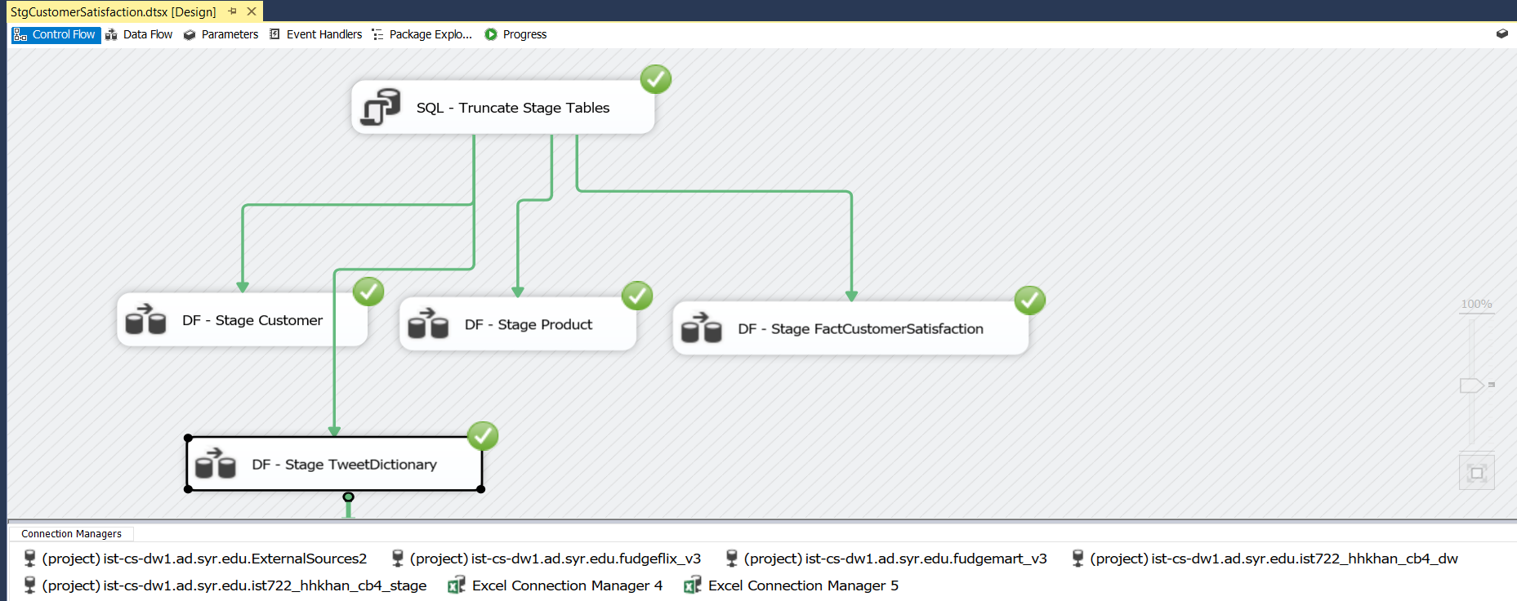
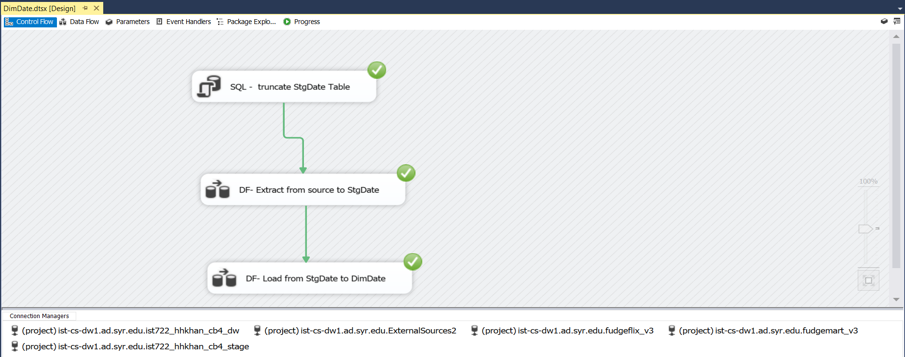
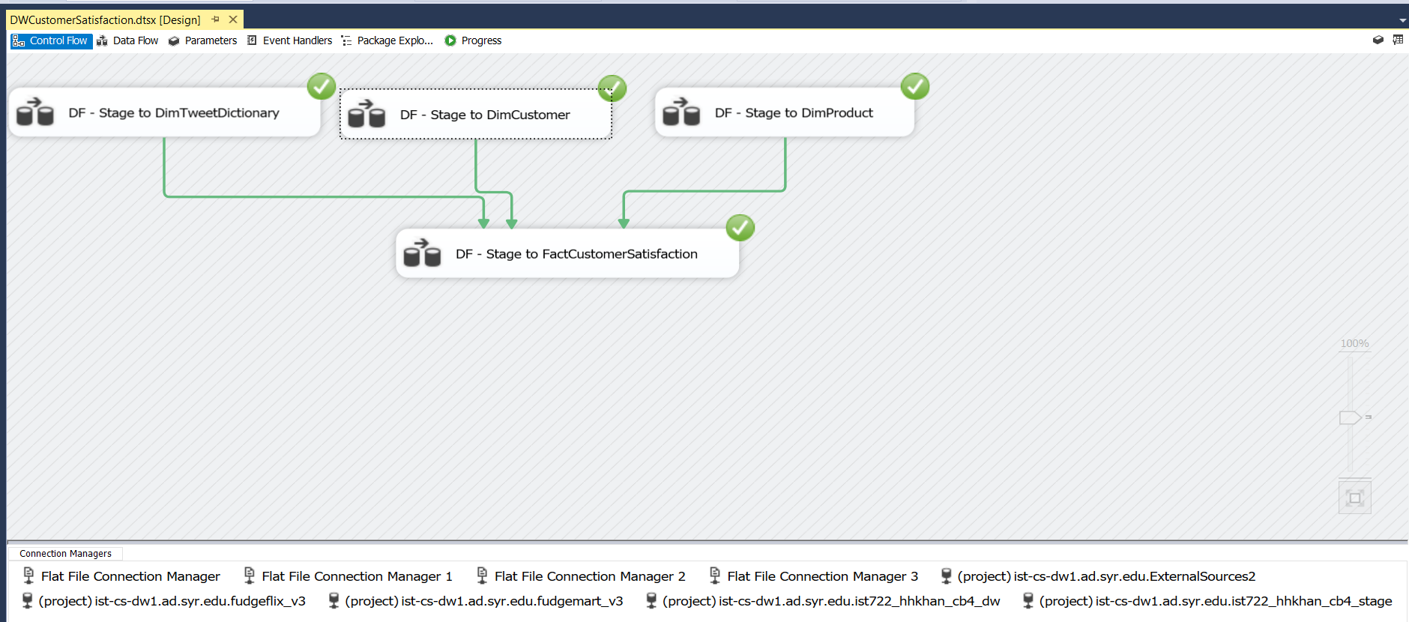
Source to Stage
Source to DimDate
Stage To Data Warehouse

Slide 9
Business Intelligence

Slide 10
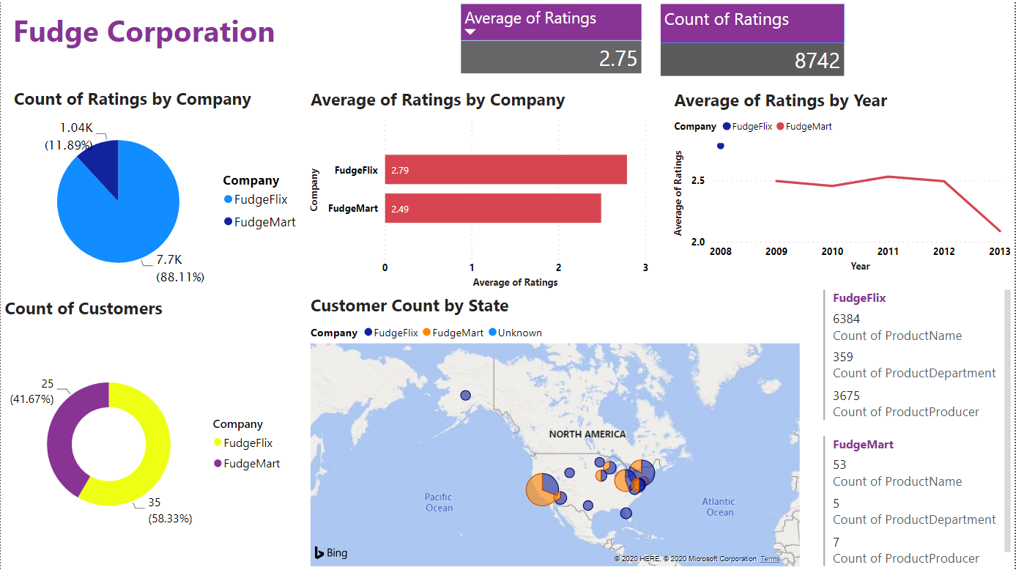
Fudge Corporation Overview

Slide 11
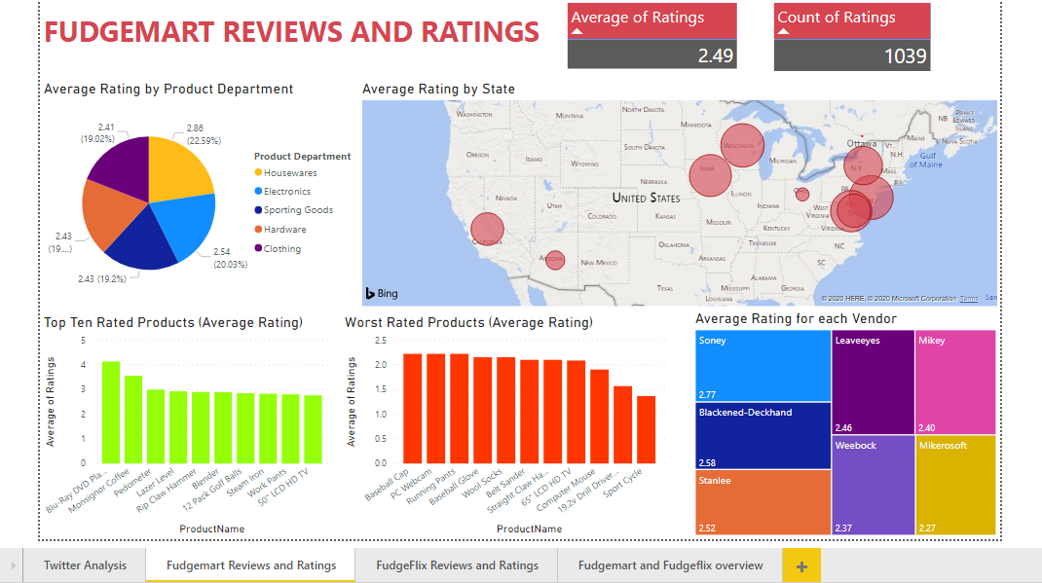
FudgeMart

Slide 12
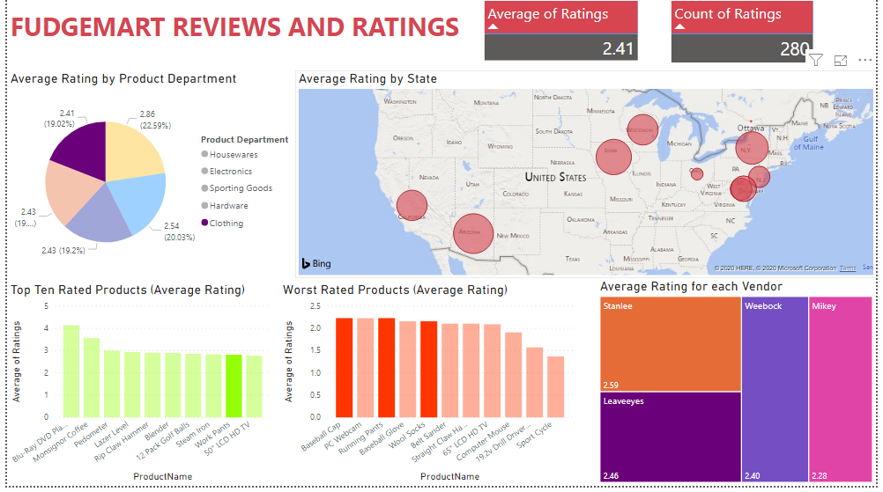

Slide 13
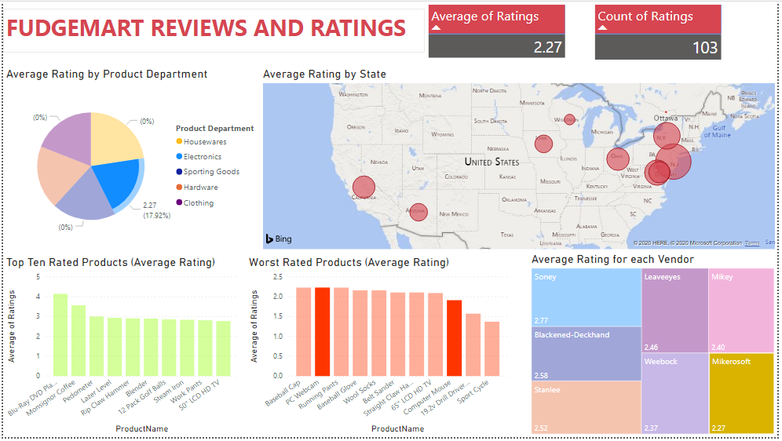

Slide 14
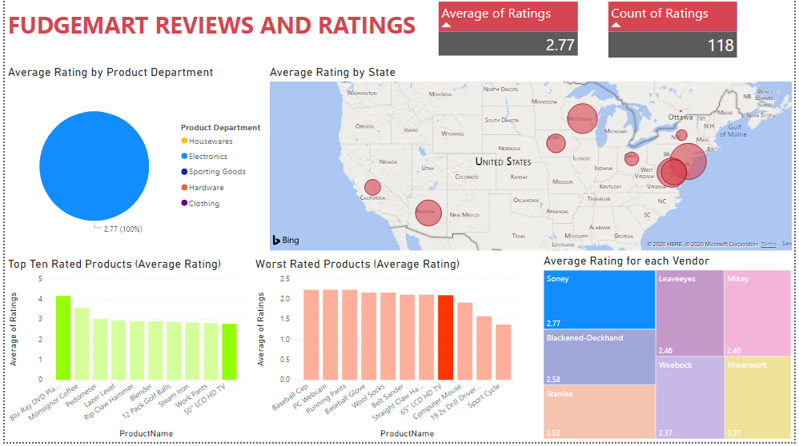

Slide 15
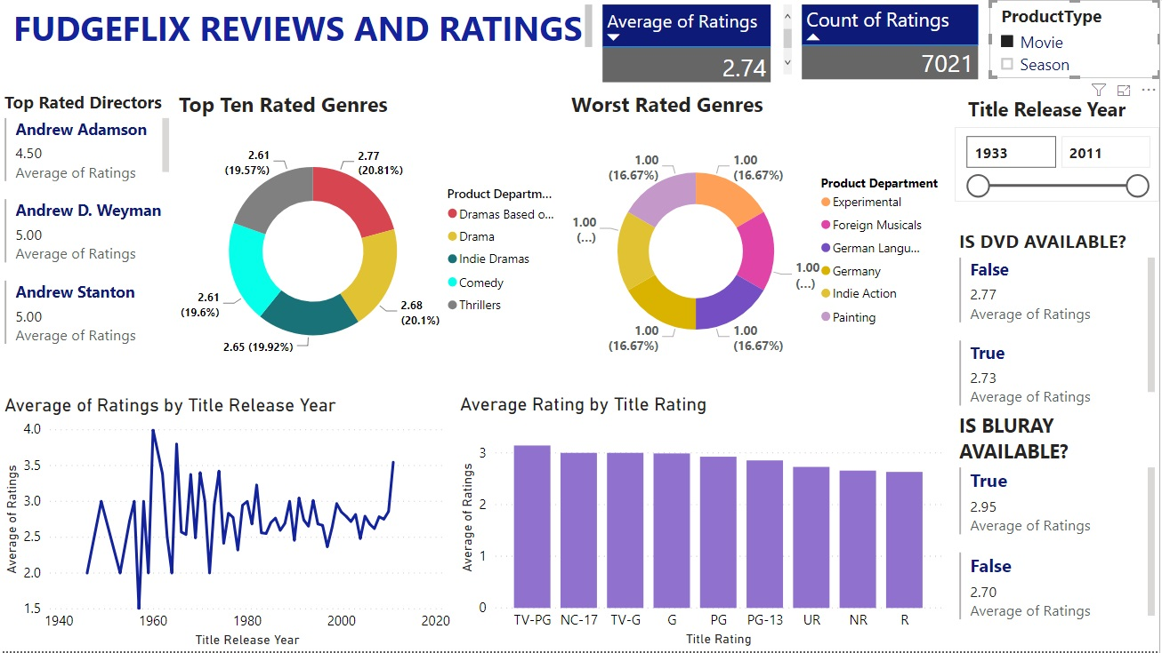

Slide 16
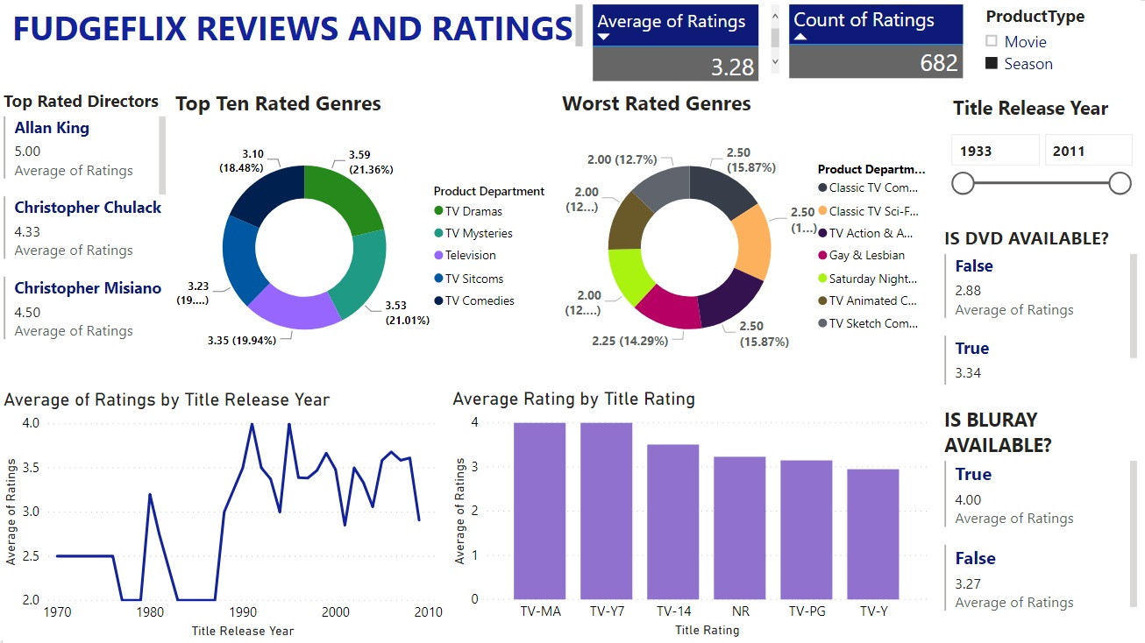

Slide 17
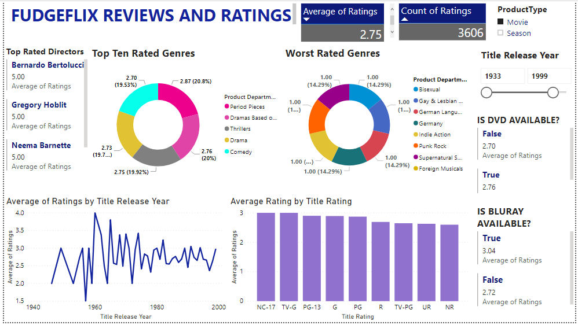

Slide 18
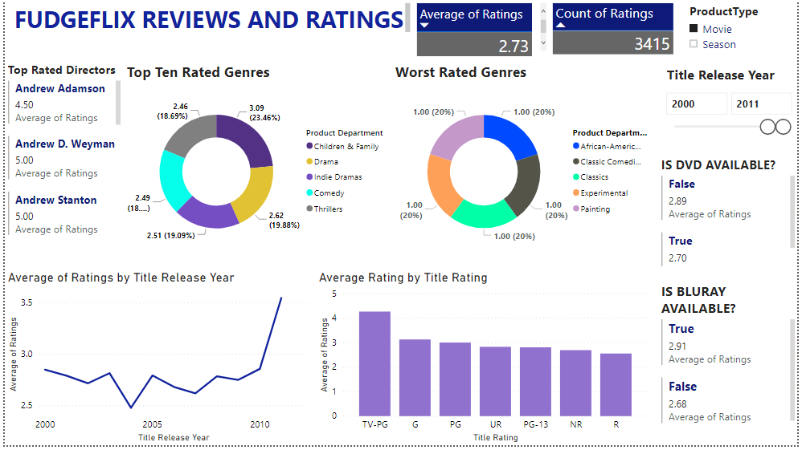

Slide 19
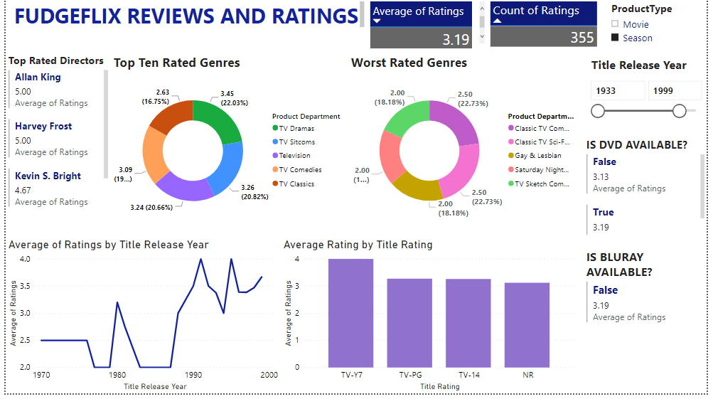

Slide 20
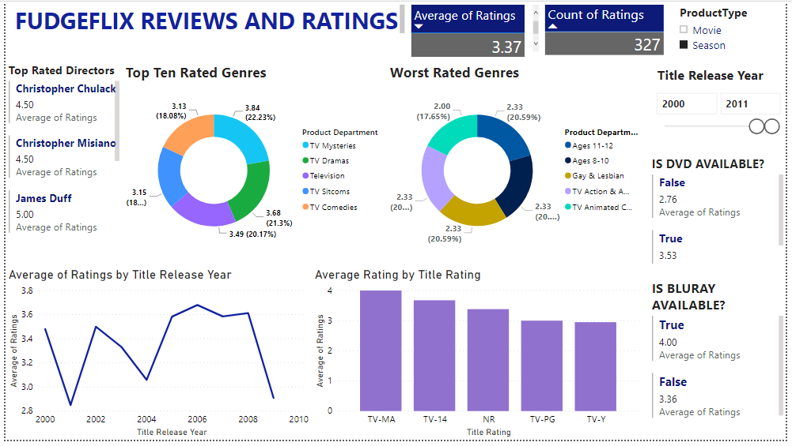

Slide 21
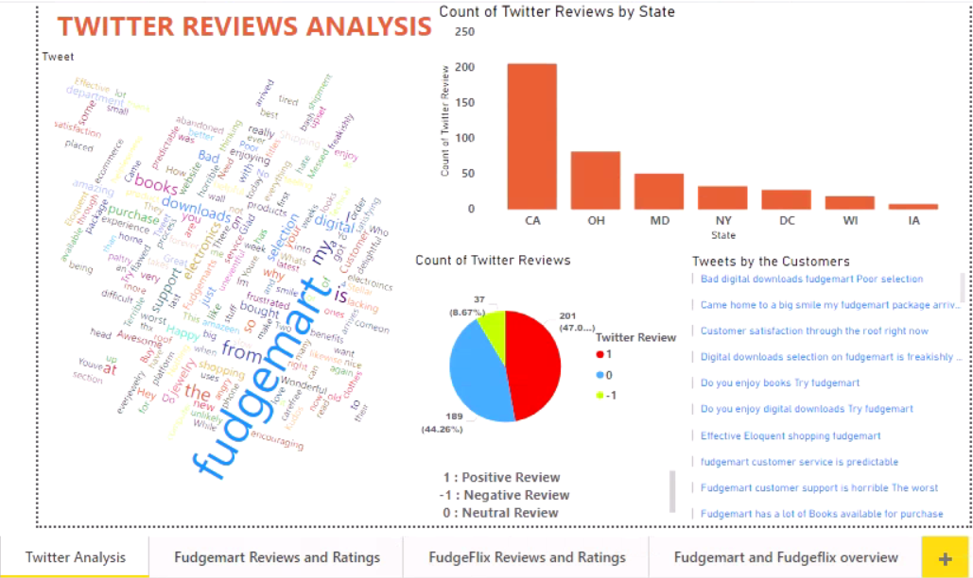
Tweet Analysis

Slide 22
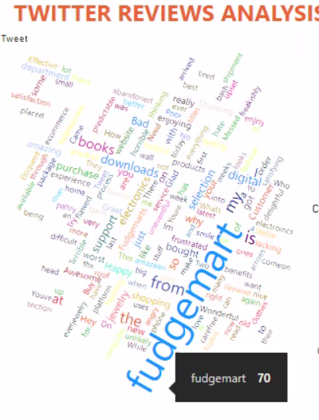
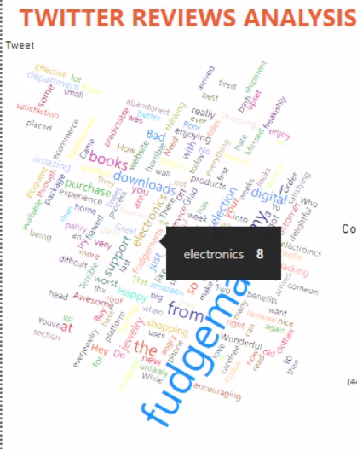

Slide 23
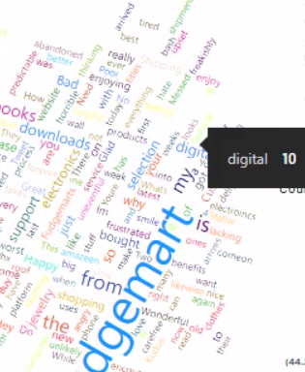
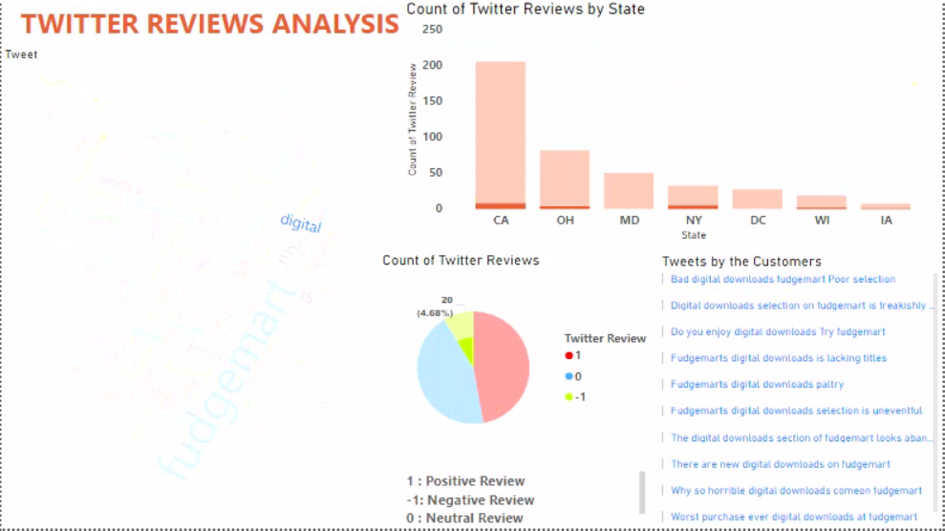

Slide 24
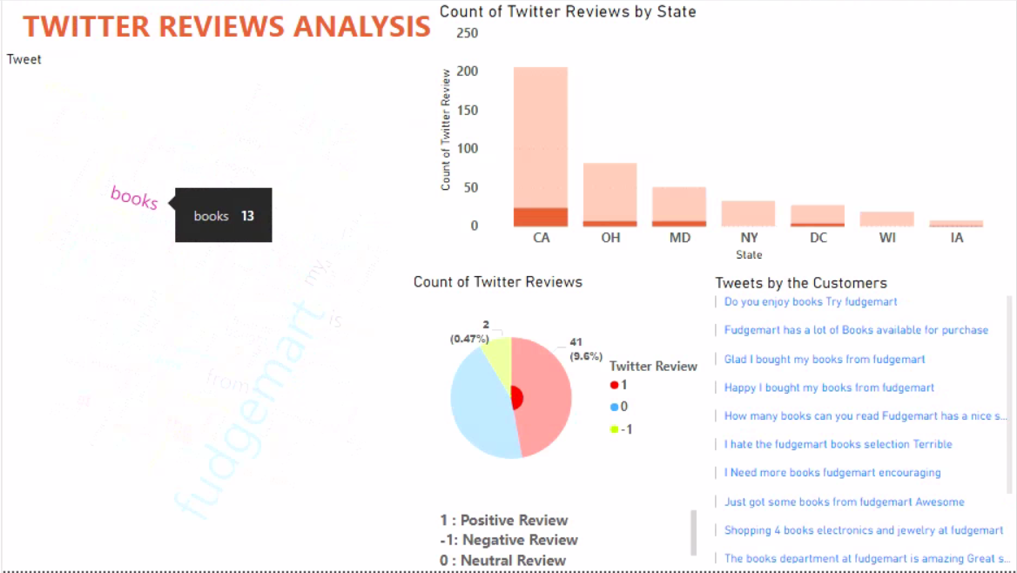

Slide 25
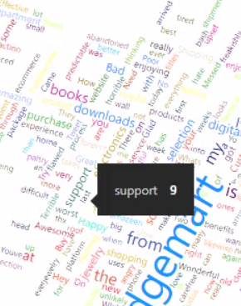
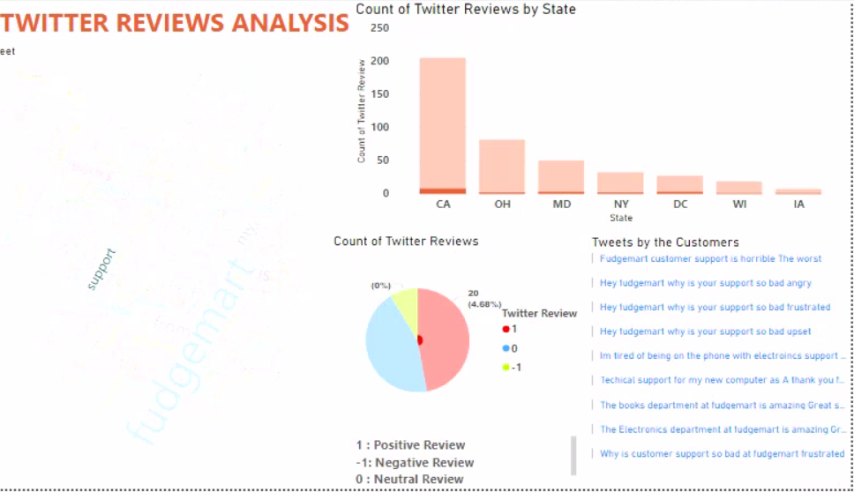

Slide 26
Recommendations
Expand customer engagement across the United States particularly in the east coast by introducing new products.
Improve the range of products and titles catering to the likes and dislikes of the target audience.
Increase the supplies from top performing vendors and cut the supplies from worst performing vendors or make amendments to the contract.

Slide 27
Thank you

